Slide 1
Sustainable Accessibility: A Fortune 50 Story
03/23/2018
Disclosure: Views represented are those of the presenters and not necessarily State Farm.

Slide 2
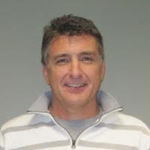
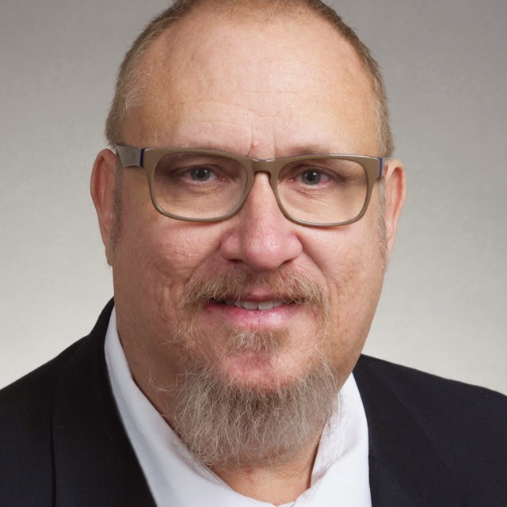
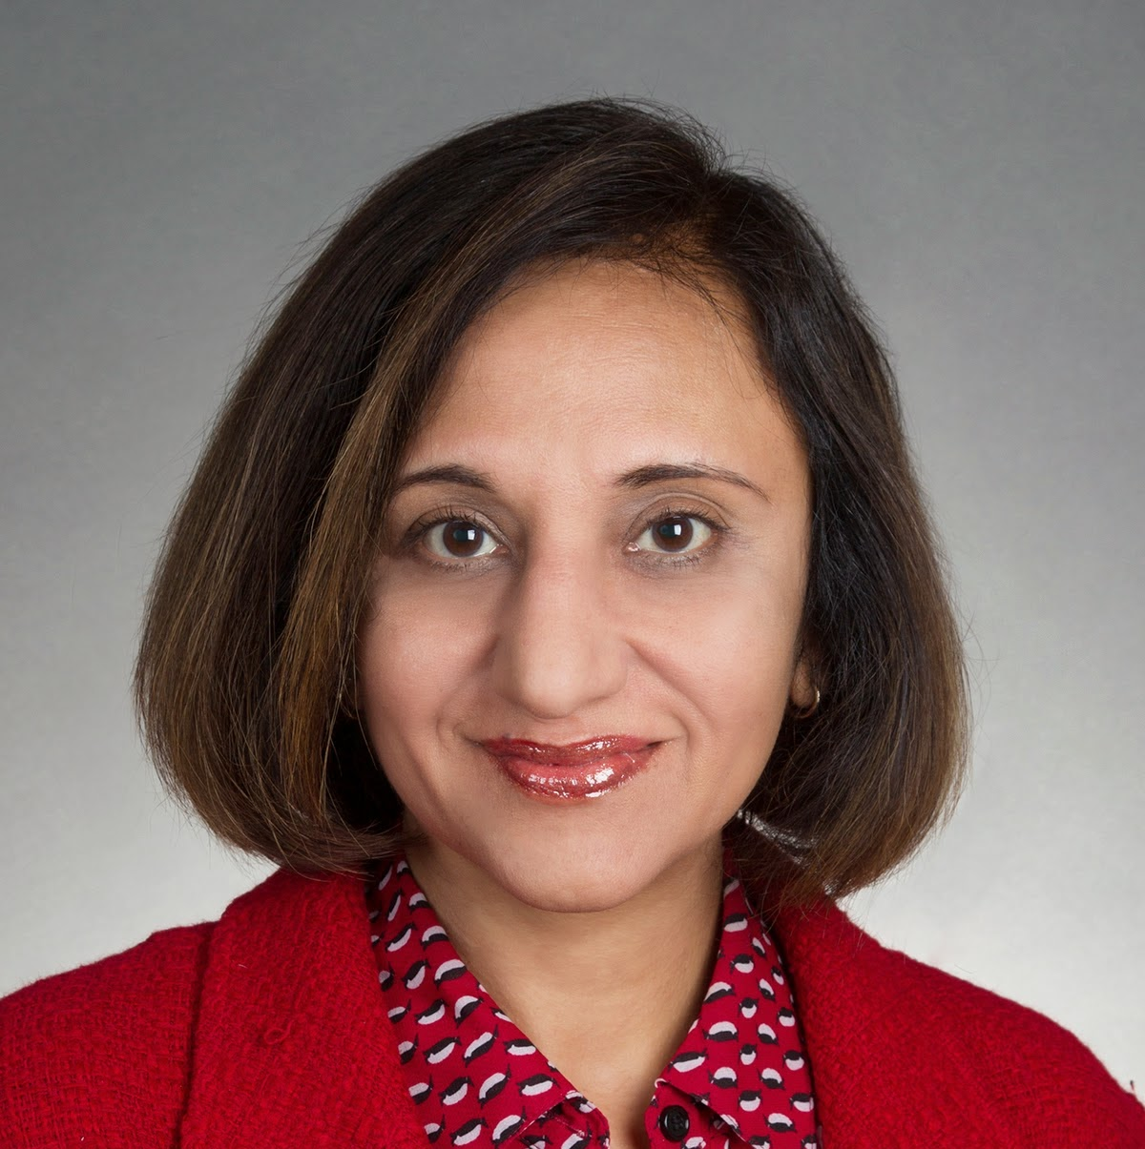
Introductions
Andy Nelson
Digital Accessibility Specialist
State Farm Insurance
CB Averitt
Senior Consultant
Deque Systems
Preety Kumar
CEO
Deque Systems

Slide 3
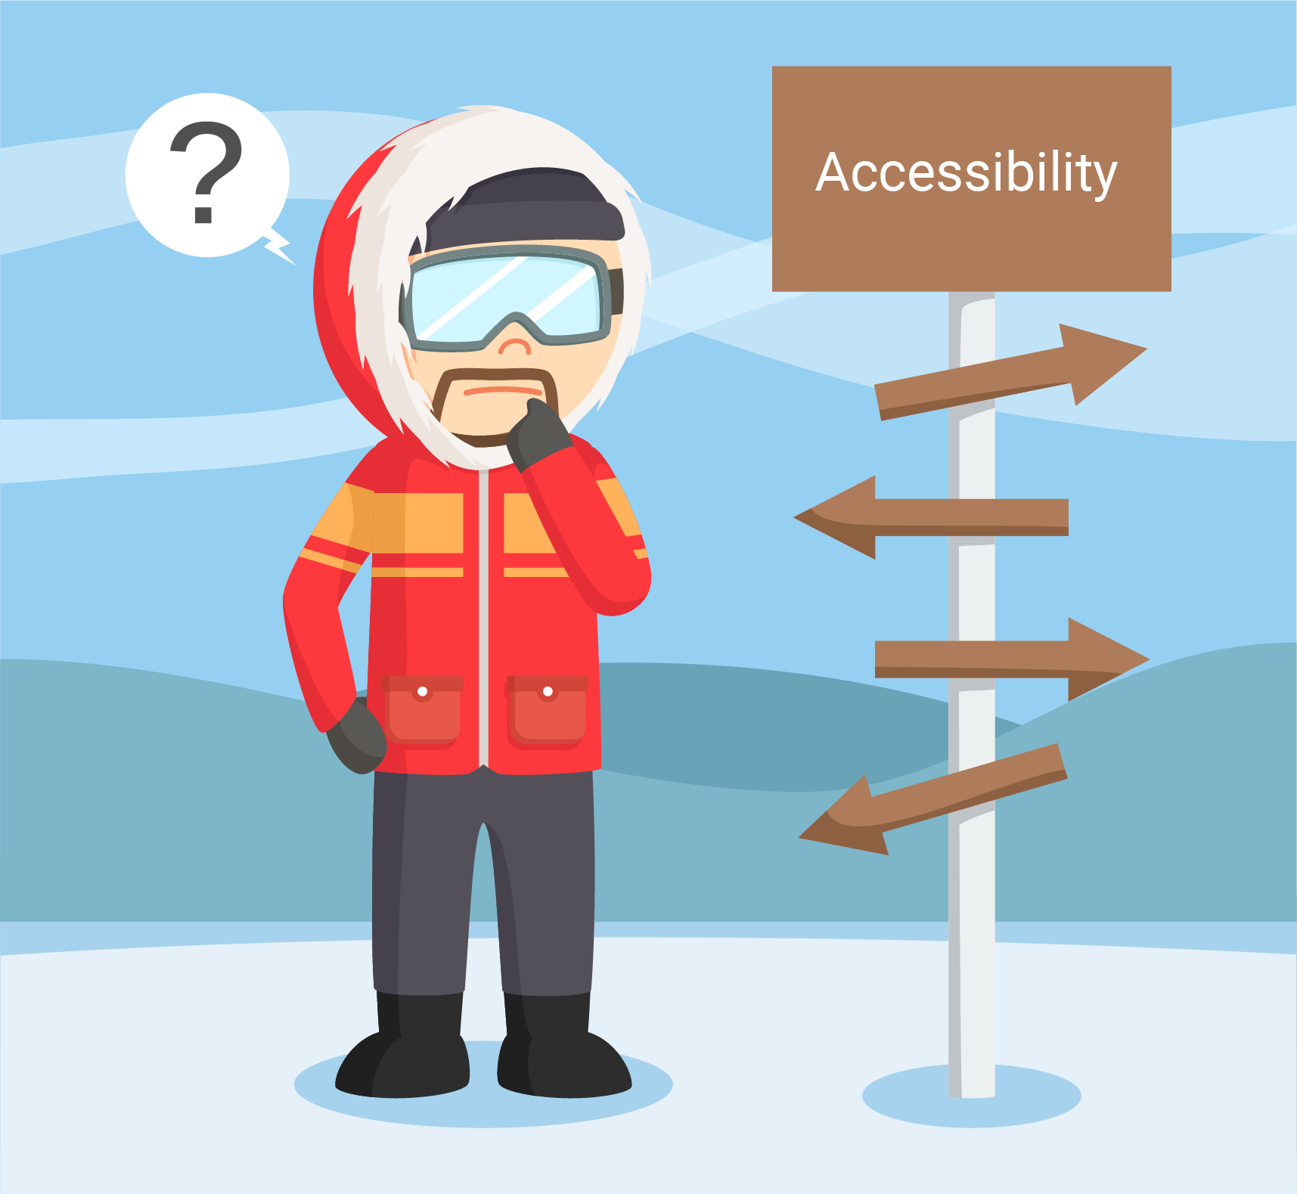
Dateline: March 2013 – Code Red
A11y Scope – 0%
A11y Coverage – 0%
Automation – 0%
Enabling Information – 0%
Documentation – 0%
Process – 0%
Accessibility of Content – Low (unacceptable)
Customer Experience – Low (unacceptable)
Business Loss and Other Risks – High (unacceptable)
Notes:
At this point in the journey, we do not have a clear scope or plan for how we can tackle our accessibility issues – we don’t know how to get up the mountain

Slide 4
How did we get in this place?
Did not understand the priority/timeline
Did not fully comprehend the legislative implications
Did not have scope identified
Small, overworked team (2 FTE) unable to cope
Provided to new leadership to review and address
Emergency action undertaken for six month (very expensive) effort
Almost all manual work (no automation) ☹
Despite all this – we fixed the final WCAG 2.0 A defect on 12/29!

Slide 5

Dateline: January 2014 – Code Red
A11y Scope – 30%
(Ontario, CA related content only)
A11y Coverage – 30%
Automation – 20%
Enabling Information – 20%
Documentation – 20%
Process – 40%
Accessibility of Content – WCAG 2.0 A, only for 30% coverage
Customer Experience – WCAG 2.0 A, only for 30% coverage
Business Loss and Other Risks – High (unacceptable)
Notes:
All of these statistics increased from 0%. We’ve started our journey, but we know the task ahead of us will be difficult but we are slowly moving towards the peak.

Slide 6
What’s Next?
Tell the story of continuing to perfect AODA
Tell the story of building the business case for US Public Facing Content – at WCAG 2.0 AA
Tell the story of focusing on enabling information
Tell the story of focusing on automation
Tell the story of partnership to build automation tooling
Business Decision Document including sampling assessment, extrapolation of level of effort, etc.

Slide 7
Dateline: January 2015 – Code Red
A11y Scope – 30%
(Ontario, CA related content only)
A11y Coverage – 30%
Automation – 20%
Enabling Information – 20%
Documentation – 20%
Process – 40%
Accessibility of Content – WCAG 2.0 A, only for 30% coverage
Customer Experience – WCAG 2.0 A, only for 30% coverage
Business Loss and Other Risks – High (unacceptable)
Notes:
I would maybe not include this slide and just note that you are where you were at before AODA

Slide 8
Selling the Business Case
Helping everyone understand disability, accommodation, and accessibility
Inspiring through empathy exercises
Clearly defining the People with Disabilities population and potential percentage of our customer base (and prospective customers) requiring accommodation
Demonstrating the potential to achieve WCAG 2.0 AA at a reasonable cost

Slide 9
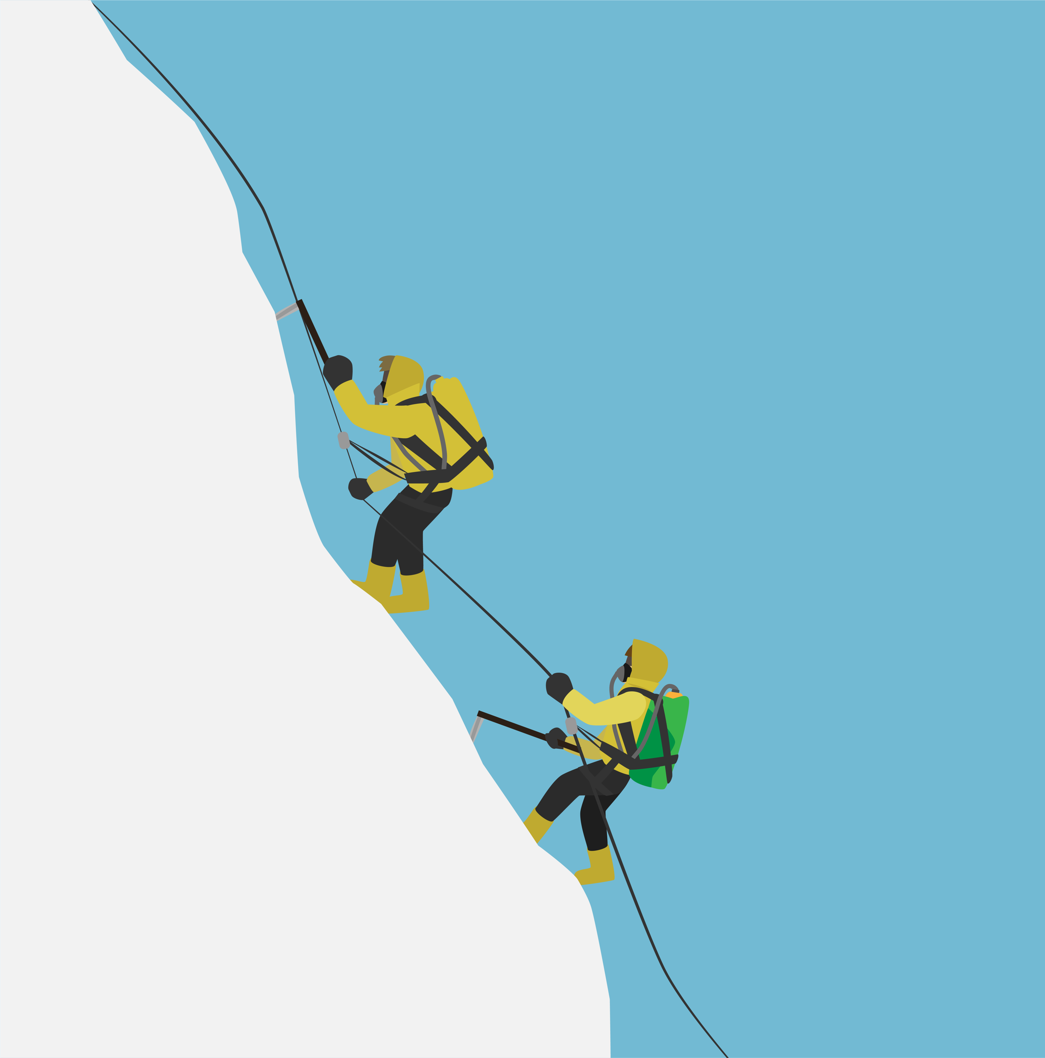
Dateline: June 2015 – Code Yellow
A11y Scope – 30%
(Ontario, CA related content only)
A11y Coverage – 30%
Automation – 35%
Enabling Information – 50%
Documentation – 75%
Process – 75%
Accessibility of Content – WCAG 2.0 A, only for 30% coverage
Customer Experience – WCAG 2.0 A, only for 30% coverage
Business Loss and Other Risks – High (unacceptable)
Notes:
Journey Notes: Hard work kicks in, seen growth in the statistics bolded above (automation, enabling information, documentation and process).

Slide 10

Preparing for Exponential Scope Increase!
Communication plans
Staff increases
Early adoption of native mobile and static content
Creation of WCAG 2.0 AA frameworks
Creation of training
Process Integration
Revise/Update Digital Standards
Standardized Legal Language for Third Party Content Providers
Notes:
Journey Notes: We are a climbing on a vertical mountain face, our scaling tactics will exponentially increase

Slide 11

Dateline: January 2016 – Code Green(ish)
A11y Scope – 75%
(WCAG 2.0 AA all public facing content)
A11y Coverage – 50%
Automation – 40%
Enabling Information – 70%
Documentation – 85%
Process – 90%
Accessibility of Content – Target WCAG 2.0 AA, all public content
Customer Experience – Becoming WCAG 2.0 AA, all public content
Business Loss and Other Risks – Medium
Notes:
Journey notes: The end in in sight, we have significantly improved in the bolded fields above, almost to the top of the mountain, all of our goals are in sight and improving

Slide 12
WCAG 2.0 AA In Progress
All content creation and revision is engaged for a11y
Multi-step process utilized
Consistent, repeatable, accessibility verification testing
Exception process to track items missed or found too late
Hundreds of pages under review/action simultaneously
Working well, but still somewhat expensive and heavy
Continually evaluating, revising, and improving approach/process
Looking to the future of automation and product suites

Slide 13

Dateline: June 2016 – Code Green(ish)
A11y Scope – 75%
(WCAG 2.0 AA all public facing content)
A11y Coverage – 65%
Automation – 45%
Enabling Information – 90%
Documentation – 100%
Process – 100%
Accessibility of Content – Target WCAG 2.0 AA, all public content
Customer Experience – Becoming WCAG 2.0 AA, all public content
Business Loss and Other Risks – Medium
Notes:
Journey Notes: Almost to the top of the mountain, but we still need to put a11y in scope, increase our coverage, automation, and enabling information

Slide 14
Looking to the Future – Automation & Enablement
SHIFT LEFT!
Special efforts to increase automation percentage
Product suite evaluations to self-enable content producing teams
ROI work to justify product expenditures
Continued refinement of process and procedure
Defect capture statistics drastically improving
Defects to production drastically decreasing
Ready to go to the next step

Slide 15

Dateline: January 2017 – Code Green(ish)
A11y Scope – 75%
(WCAG 2.0 AA all public facing content)
A11y Coverage – 75%
Automation – 50%
Enabling Information – 100%!!
Documentation – 100%
Process – 100%
Accessibility of Content – Target WCAG 2.0 AA, all public content
Customer Experience – Becoming WCAG 2.0 AA, all public content
Business Loss and Other Risks – Medium
Notes:
Journey Notes: Almost to the top of the mountain, our coverage should be higher, Automation has grown, but we did reach 100% enabling information. We still need to raise the a11y scope up to 100%.

Slide 16
We Have Our Suite! (and what about employees?)
Product suite selected and purchased
Rollout underway
Shifting left all the way to build
Experimenting with self-service
Implementing scorecards for critical content
Increased focus on internal (employee) facing content
Refining process, procedure, and engagement for new tools
Pursuing even high yet automation goals

Slide 17

Dateline: January 2018 – Code Green!!
A11y Scope – 100% !!!
A11y Coverage – 75%
Automation – 50% (but growing)
Enabling Information – 100%
(continuously revised/updated)
Documentation – 100%
Process – 100%
Accessibility of Content – Target WCAG 2.0 AA, all content
Customer Experience – Becoming WCAG 2.0 AA, all content
Business Loss and Other Risks – Low
Notes:
Journey Notes: We reached the top of the peak, A11y scope is 100%, we still have room for improvement for automation and coverage, but business loss and other risks are finally low.

Slide 18
Where do we go from here?
Already achieved efficiencies due to product suite implementation
Increased focus on internal (employee) facing content
Maturing scorecards for critical content
Shifting left for more and more content teams
Moving to some content teams doing 100% of their own testing
Focusing on design and frameworks
Digital Accessibility Enterprise Policy Implemented (with risk track)
Continue to improve efficiency, effectiveness, and cost/ROI

Slide 19
Questions?
Preety Kumar
CB Averitt
@dive4cb on Twitter
Andy Nelson

